Slide 1

Infomineo offers a full suite of Data Analytics Services
Analytics
Three Levels of Analytics
Business Oriented Approach
Four Types of Support
Gathering Data from various storage, Assessing Data Quality and processing cleaning and wrangling
Data Exploration & Cleaning
Data Visualization : KPIs, automated dashboards & reports
Acquisition & Preparation
Infomineo’s teams demonstrate a high Business sense
We work in an iterative approach to fulfill clients needs quickly
Data Analysis
Business & Data Understanding
Agile Methodology
Statistical Analysis
Model building & tuning
Model evaluation & retraining
Exploration & Visualization
Building and maintaining self service analytics.
Data
Science
Delivery Management
Modeling
Building predictive and prescriptive models
Data Sourcing & Integration
Feature Engineering, Data transformation
Model Deployment & scalability
Data Engineering
Release & Change Management are handled: versioning, unit tests, model validation, documentation…
Model deployment in clients’ infrastructure, model monitoring, interfacing …
Deployment

Slide 2






Our approach to helping you
Analytics
Intake
Execution
Delivery
Understanding client needs and objective
Get a deep understanding of the client objectives:
Type of analytics support considered
Business questions to answer
Assess available data, data needs if any, critical data elements to take care of
Planned use of the analytics outputs
Structuring approach
Define the best data analytics strategy to answer the client’s business objective
Estimate the time needed
Define the type of output needed
Executing Analytics
Leveraging a full range of analytics capabilities
Data Preparation
Identifying Data Sources
Extracting & Transferring Data
Metadata & Dictionaries
Merging of various data sources & adding new data
Assessing Data Quality
Handling Outliers
Restructuring Data for analysis
Making features extractions
Business & Data Under
standing
Agile Metho
dology
Data Modeling
Build algorithms to answer the business question (binary classification, segmentation, forecasting …)
Evaluation and validation of the algorithm
Deriving insights
Performing in-depth quality assurance
Analyzing the data outputs to derive insights in line with the initial client ask
Handover
Presenting the approach, results and potential limitations
Sharing all the documentation & codes
Getting client feedback
Definining scaling with clients’ IT Teams (to be scheduled if any)
Performing regular model maintenance (to be scheduled if any)
Delivery Management
Exploratory Analysis
Descriptive analysis
Data visualization
KPIs
Data story telling

Slide 3
Acquire & Preparation
Analyze
Deliver
Data Sources
Integration
Storage
Preparation
Exploration &
Visualization
Modeling
Deployment
ERP
Warehousing
Environment
Statistics
Prescriptive Analytics
Recommendation Systems
Model Monitoring
Batch Data Integration
Data Quality
Time series
Predictive Analytics
DS/ML Platforms
CRM
Feature Engineering
Segmentation
NOSQL Environment
Simulation
and Optimization
Version Control
Databases
Stream Ingestion Real time
Data Cleaning
Reports
Machine Learning
Orchestration
Speech Analytics
Big Data/Distributed Environment
Deep Learning
Video/Image Analytics
Security
External Sources
Dashboard
Text Analytics
Message Broker
Data Transformation
Graph Analytics
Containerization
Sentimental/ Behavioral Analytics
Files
Cloud
Environment
Real time Reporting
Geospatial and
Location Analytics
Interfacing

Slide 4











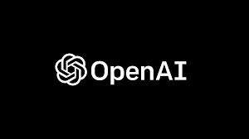
































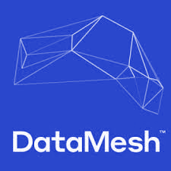
















Technologies Infomineo can be handling
Machine Learning
Statistics
DS/ML Platforms
Real time
VertexAI
Visualisation
Oryx
Orchestartion
Data Robot
Seaborn
Gradio
Streamlit
Flask
Django
React native
Google API, Twitter API, beautifulsoup4,octoparse
Interface
Data Sourcing
Github, GitLab
Containerization
Warehousing
NOSQL
Big Data/
Distributed
Cloud

Slide 5














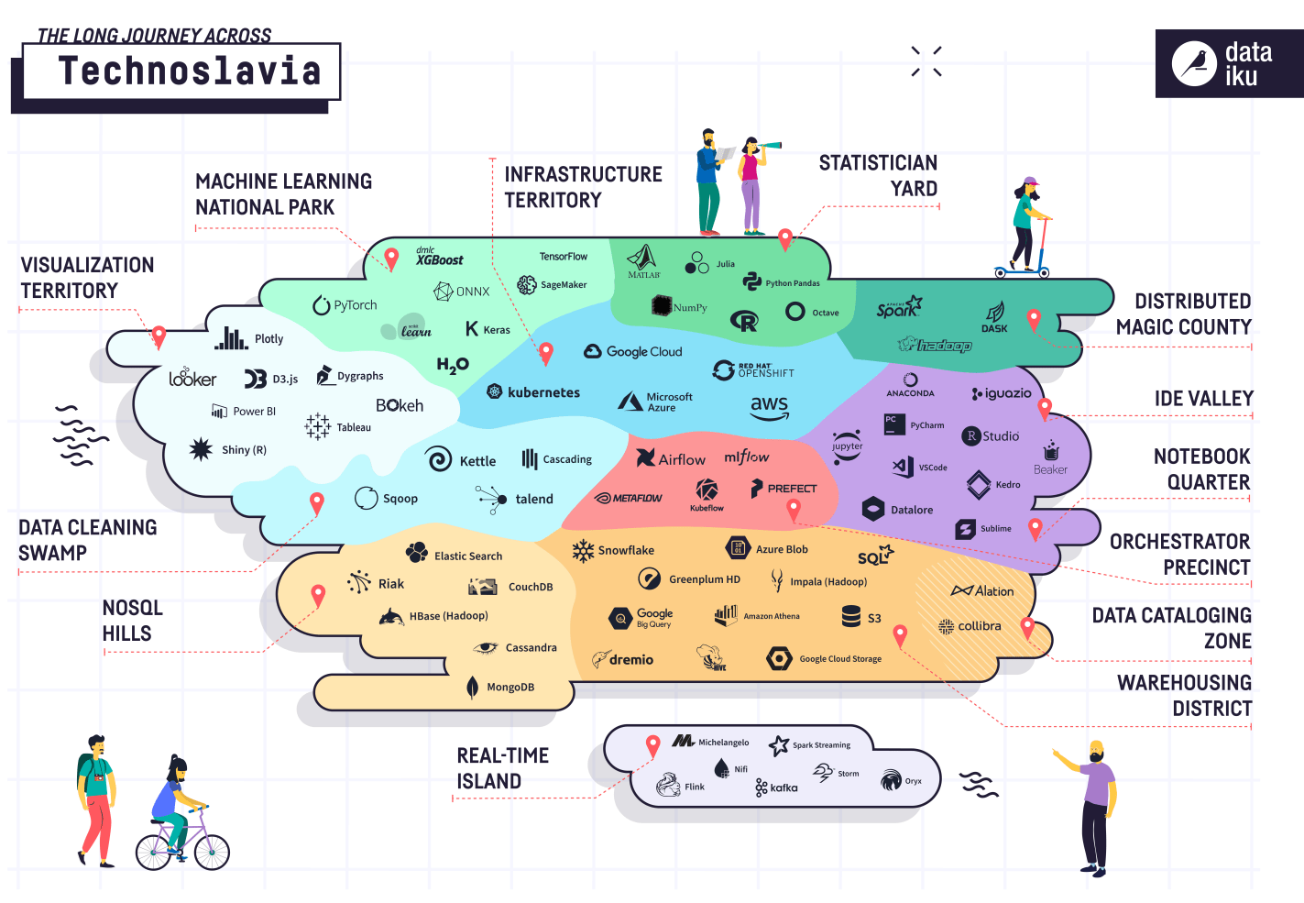
















Technologies Infomineo can be handling
Statistician yard
Distributed magic county
Machine learning National Park
Ide Valley
Infrastructure territory
Notebook quarter
Capabilities we already have
Visualization territory
Capabilities we are building
Orchestrator precinct
Big Data/
Distributed
NOSQL
Warehousing
Real-time island

